Slide 1
GRACE CAMPUS
The mission of Grace Campus is to inspire hope, instill value, and equip the homeless in our community.
It is our desire to not only provide temporary shelter for the homeless in Lubbock, but to also come alongside these individuals helping them prepare mentally, physically and spiritually as they work to move out of the cycle of homelessness.

Slide 2
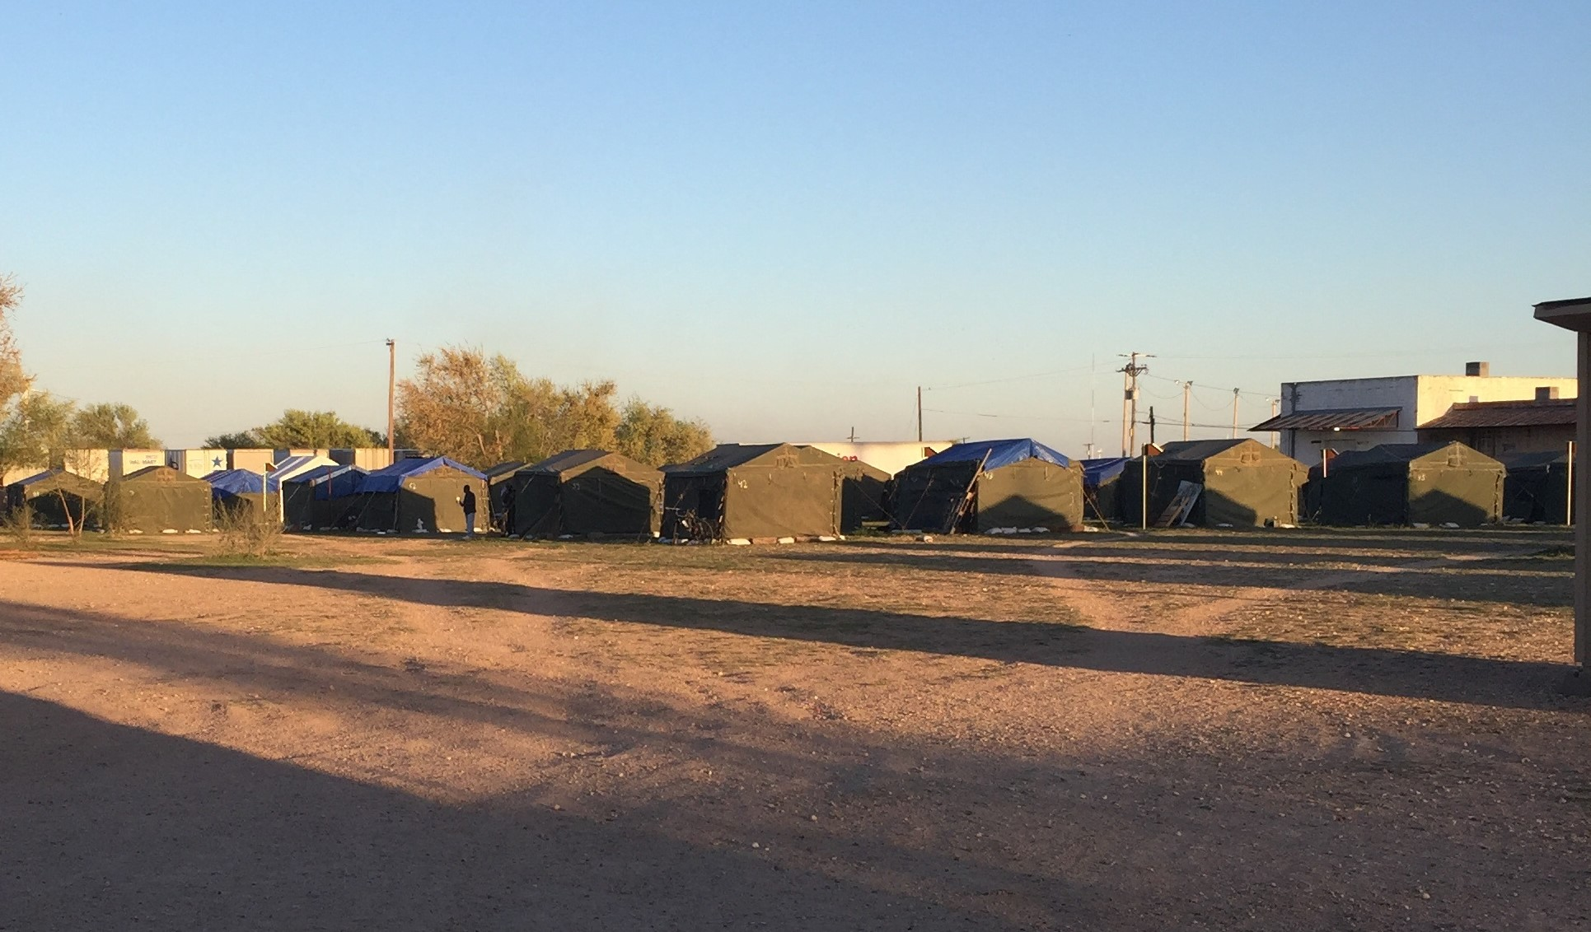
IN THE BEGINNING:
There were 42 individuals living on the property in 48 army tents.
The only common area was a large uninsulated old metal building with holes throughout it.
The tents were worn-out and often flooded. Rodents and insects were a huge problem due to the conditions.
Individuals had no way to lock up their belongings or their doors at night.

Slide 3
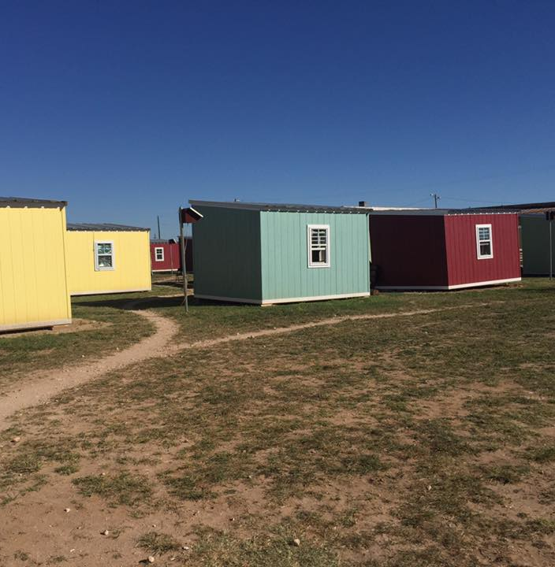
Grace Campus Today:
58 tiny houses have replaced all the worn army tents.
Approximately 90 homeless individuals stay in the houses while they work to move towards independent living.
The property is divided into two parts. One side provides shelter for men and the other side for women and couples.
The insulated barn provides emergency shelter for anyone in need during inclement weather.
Grace Campus is a 6-month transitional program. It is designed to help individuals remove the obstacles that are holding them back from independent living.

Slide 4
THINGS TO KNOW ABOUT GRACE CAMPUS…
Paul’s Project is a stand alone 501c3 overseen by a Board of Directors. Our goal is for all individuals to set aside differences and simply focus on providing hope and love to a population that desperately needs it.
Paul’s Project does not receive any government funding. We exist thanks to the generous donations of churches, groups, and individuals in our community.
Typically have 85-95 homeless individuals in program. We also offer emergency shelter to any homeless individual in our community during inclement weather.
We partner with some amazing organizations/agencies in an effort to best assist the individuals that come through our gates in getting back on their feet.
We believe there is no “cookie cutter” way to address homelessness. Instead, we must meet people where they are at and take the time to address each person’s own unique set of circumstances.
We have over 100 volunteers on-site each week (serving meals, working in the clothes closet, painting houses, etc…)
Individuals are required to be working /taking steps to move towards independent living while at Grace Campus. They are required to participate in chores, turn in accountability forms, and set personal goals.

Slide 5
GRACE CAMPUS
78
Grace campus provides ACCESS TO the Resources and basic necessities needed for An individual to move back towards independent living.
The Majority of the individuals at Grace Campus are considered “situationally” homeless, not “chronically” homeless.
78 people moved from Grace Campus into unsubsidized housing in 2018 and 97 people moved into unsubsidized housing in 2019.
WE PARTNER WITH NUMEROUS AGENCIES/GROUPS IN OUR COMMUNITY DOING AN AMAZING JOB, RATHER THAN DUPLICATE SERVICES ALREADY PROVIDED.
Grace CAMPUS was awarded Guidestar’s 2019 platinum seal for nonprofit transparency and awarded 2019 Top rated nonprofit by Great nonprofits.
Grace Campus served 325 people in 2018 with an operating expense of $231,113.40 for the entire year. approximately $711.12 was spent per person to provide assistance
VOLUNTEERS ARE KEY TO THE SUCCESS OF GRACE CAMPUS. TYPICALLY OVER 100 VOLUNTEERS A WEEK SERVE THE HOMELESS ON CAMPUS GROUNDS.

Slide 6
HOW CAN YOU SERVE AT GRACE CAMPUS?
Prepare and Serve an Evening Meal
Sort and Organize Donations
Participate in a Group Service Project
Teach or Facilitate a Class
Work one-on-one with individuals on Life Plans or Mentoring
Donate and provide much needed finances so we can continue to serve the homeless in our community
You Tell Us!
We are always looking for creative ways to help our clients

Slide 7
THINGS WE ALWAYS NEED:
Monthly support
Toilet Paper & Paper Towels
Cleaning supplies & laundry detergent
Plates, bowls, plastic utensils, small cups & disposable serving gloves
55 gallon/10 gallon trash bags
Fire extinguishers & batteries
Solar Panels & solar lights
Plastic containers w/lids
Bicycles & Locks
Paint, caulk, windows, tiles
Lawnmower & lawn equipment
GRACE CAMPUS WEBSITE:
www.gracecampus.org
LOCATION:
1301 Ave A (Just south of fairgrounds)
TEXT/CALL:
(806)-632-7709 or (806)-544-3365
EMAIL:
admin@paulsprojectlubbock.org
Donations can be made through our website or facebook page.
You can also text gracecampus to 707070 to give through your mobile device.
Donations through mail can be sent to:
Paul’s Project
PO Box 53891
Lubbock, TX. 79453

Slide 8
Alone we can do so little; together we can do so much ~Helen Keller~

